Slide 1


KIET Group of Institutions, Delhi-NCR, Ghaziabad
Real-Time Chat Application
Session:2024-2025 (III Semester)
Simran Tyagi (202410116100208)
Shefali Yadav (202410116100195)
Tanisha Jain (202410116100217)
Vishal Chaturvedi (202410116100248)

Slide 2


Evolution of Communication Technologies
From Email to Instant Messaging
Rise of Real-Time Platforms
Early communication technologies like email provided asynchronous communication, while the advent of instant messaging brought real-time interaction, revolutionizing how people connected.
Today, real-time platforms like chat apps and video conferencing dominate online communication, enabling instant, personalized conversations and collaborative experiences.

Slide 3
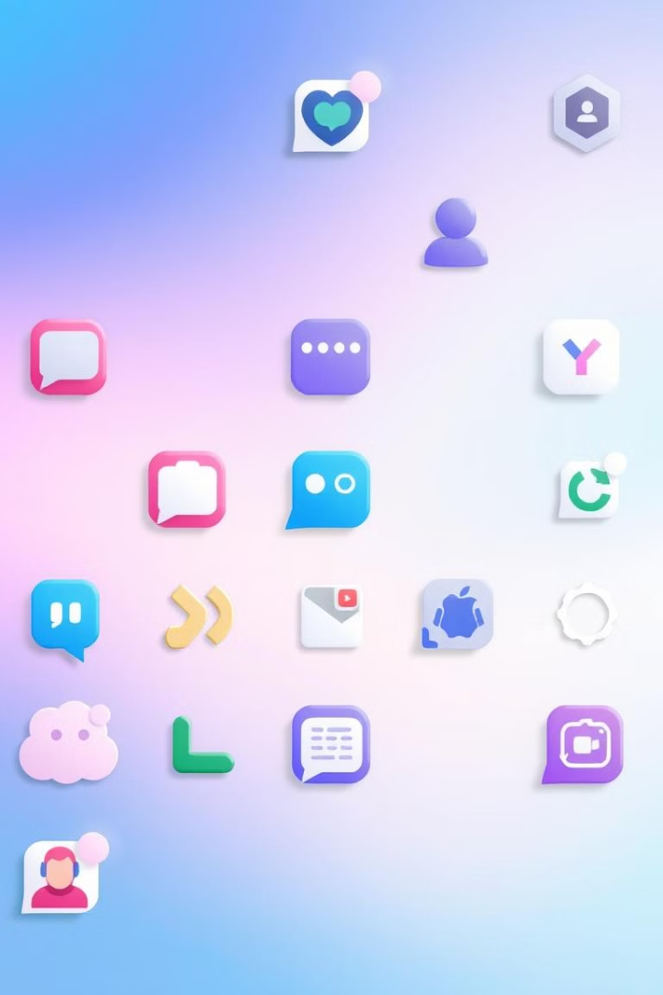
Existing Solutions and Gaps
While existing chat platforms offer features like group chat, file sharing, and multimedia messaging, they often lack a focus on user-friendly interfaces, real-time performance, and robust security.
This project aims to address these gaps by developing a lightweight, secure, and responsive chat application that prioritizes user experience and seamless communication.

Slide 4


Objectives of the Project
Primary Objectives
Our main goal is to build a robust and reliable chat application that facilitates secure communication, seamless messaging, and a user-friendly interface.
Secondary Objectives
Beyond core functionality, we aim to demonstrate best practices in full-stack development, explore cutting-edge web technologies, and create a scalable communication solution.

Slide 5





Technology Stack
React.js
Zustand
Tailwind CSS
React.js is the core of our frontend, providing a component-based framework for building interactive user interfaces.
Zustand is used for state management, offering a simple and scalable solution for managing application state.
Tailwind CSS is our utility-first CSS framework, enabling rapid UI development with a focus on customization and performance.

Slide 6





Backend Technologies
Node.js
MongoDB
Socket.IO
Runtime environment for server-side JavaScript, facilitating asynchronous event-driven architecture for scalable network applications.
NoSQL database for storing application data, offering flexible schema design and high performance for unstructured data storage.
Enables real-time, bidirectional communication between web clients and servers, facilitating instant updates and interactive experiences.
Express.js
Web application framework for Node.js, providing a robust set of features for building web and mobile applications with ease.

Slide 7





Additional Modules
JWT
Cloudinary
Axios
For secure authentication and access control, JWT (JSON Web Tokens) ensures that only authorized users can access protected resources, enhancing the overall security of the application.
For scalable media storage and management, Cloudinary provides a robust solution for handling images and videos, optimizing performance and reducing storage costs.
For easy API requests and data integration, Axios simplifies the process of making HTTP requests, enabling seamless communication between the frontend and backend components of the application.

Slide 8

Hardware Requirements
Development Environment
Server Requirements
Client Requirements
A standard laptop or desktop with adequate processing power, RAM, and storage is sufficient for development. A stable internet connection is essential for accessing online resources and deploying the application.
For hosting the application, a cloud platform like Heroku or Vercel offers scalability and reliability. The server requires sufficient resources to handle real-time communication and user traffic.
The application will run on any modern web browser, ensuring compatibility across desktops, tablets, and mobile phones.

Slide 9

Software Requirements
1
Programming Languages
JavaScript forms the backbone of both the frontend and backend, with React.js powering the user interface and Node.js handling server-side operations.
2
Database
MongoDB is our chosen database, providing flexible data storage and retrieval for user data and messages.
3
Development Tools
Visual Studio Code serves as our primary code editor, while Git enables version control, and npm/yarn manage project dependencies.

Slide 10



Core Modules
User Authentication Module
This module ensures secure user registration, login, and logout functionality, employing password encryption and JWT token management.
Messaging Module
This module enables real-time message sending, storage, and tracking of user status, facilitating seamless communication between users.

Slide 11
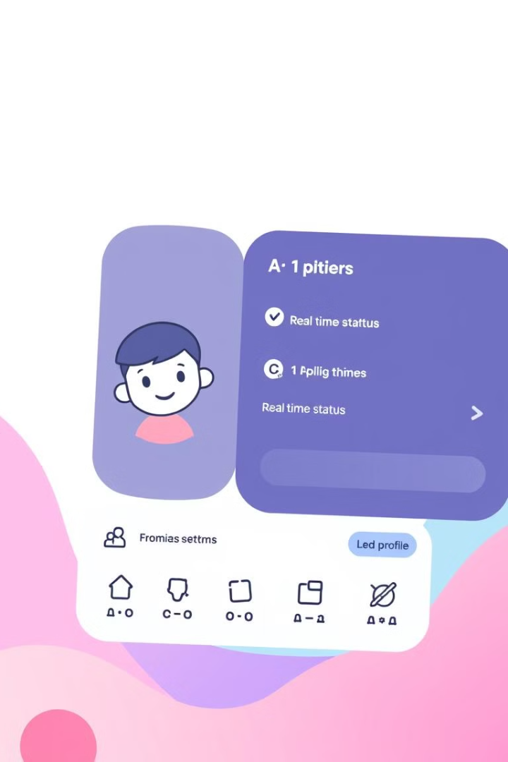

Additional Modules
User Profile Module
This module allows users to manage their profiles, upload avatars, and track their online/offline status, enhancing user personalization and engagement.
Media Sharing Module
This module enables image and file sharing, leveraging Cloudinary for secure and scalable media storage, enriching the communication experience.

Slide 12
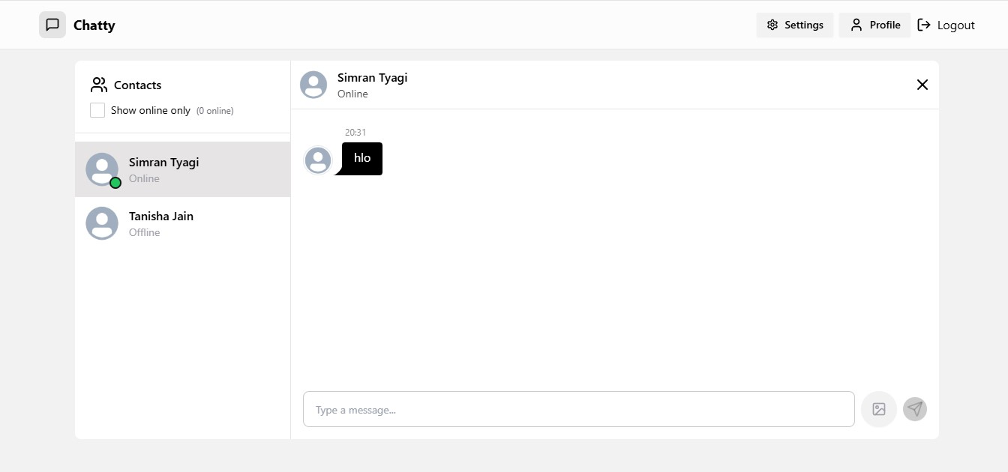

Slide 13







Application Workflow
Dashboard/User List
2
User Registration/Login
1
Select Conversation
3
5
User Logout/Session Management
4
Real-time Messaging
This workflow ensures a seamless and intuitive user experience, allowing users to register, log in, access their dashboard, select conversations, engage in real-time messaging, and log out securely.

Slide 14



